Slide 1
Lecture 1 Propositional Logic
By
Prof. M B Narnaware
(Assit. Prof. @IT-WCE)

Slide 2
What is Mathematics, really?
It’s not just about numbers and symbols!
Mathematics is much more than that:
Mathematics is, most generally, the study of any and all absolutely certain truths about any and all perfectly well-defined concepts.
It is a way to interpret the world around you for Machines.

Slide 3
So, what ’s this class about?
What are “discrete structures” anyway?
“Discrete” - Composed of distinct, separable parts. (Opposite of continuous.)
discrete:continuous :: digital:analog
“Structures” - Objects built up from simpler objects according to some definite pattern.
“Discrete Mathematics” - The study of discrete, mathematical (i.e. well-defined conceptual) objects and structures.

Slide 4
Why Study Discrete Math?
The basis of all of digital information processing is: Discrete manipulations of discrete structures represented in memory.
It’s the basic language and conceptual foundation for all of computer science.
Discrete math concepts are also widely used throughout math, science, engineering, economics, biology, etc., …
A generally useful tool for rational thought!

Slide 5
Propositional Logic
Logic
Study of reasoning.
Specifically concerned with whether reasoning is correct.
Focuses on the relationship among statements, not on the content of any particular statement.
Gives precise meaning to mathematical statements.
Propositional Logic is the logic that deals with statements (propositions) and compound statements built from simpler statements using so-called Boolean connectives.
Some applications in computer science:
Design of digital electronic circuits.
Expressing conditions in programs.
Queries to databases & search engines.

Slide 6
Definition of a Proposition
Definition: A proposition (denoted p, q, r, …) is simply:
a statement (i.e., a declarative sentence)
with some definite meaning, (not vague or ambiguous)
having a truth value that’s either true (T) or false (F)
it is never both, neither, or somewhere “in between!”
However, you might not know the actual truth value,
and, the truth value might depend on the situation or context.
probability theory, in which we assign degrees of certainty (“between” T and F) to propositions.
But for now: think True/False only! (or in terms of 1 and 0)

Slide 7
Examples of Propositions
It is raining.
Beijing is the capital of China.
2 + 2 = 5.
1 + 2 = 3.
A fact-based declaration is a proposition, even if no one knows whether it is true
11213 is prime.

Slide 8
Examples of Non -Propositions
The following are NOT propositions:
Who’s there? (interrogative, question)
Just do it! (imperative, command)
La la la la la. (meaningless interjection)
Yeah, I sorta dunno, whatever... (vague)
1 + 2 (expression with a non-true/false value)
x + 2 = 5 (declaration about semantic tokens of non-constant value)

Slide 9
Truth Tables
An operator or connective combines one or more operand expressions into a larger expression. (e.g., “+” in numeric expressions.)
Unary operators take one operand (e.g., −3);
Binary operators take two operands (e.g. 3 + 4).
Propositional or Boolean operators operate on propositions (or their truth values) instead of on numbers.
The Boolean domain is the set {T, F}. Either of its elements is called a Boolean value.
An n-tuple (p1,…,pn) of Boolean values is called a Boolean n-tuple.
An n-operand truth table is a table that assigns a Boolean value to the set of all Boolean n-tuples.

Slide 10
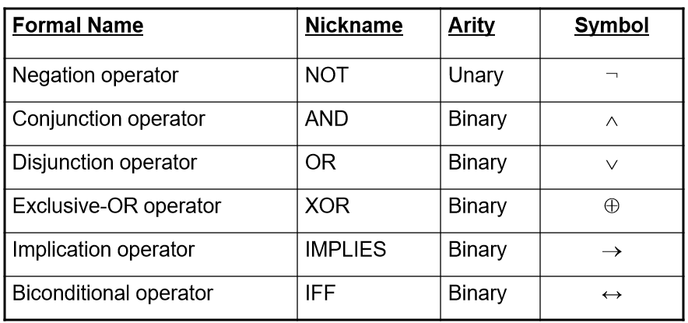
Some Popular Boolean Operators

Slide 11
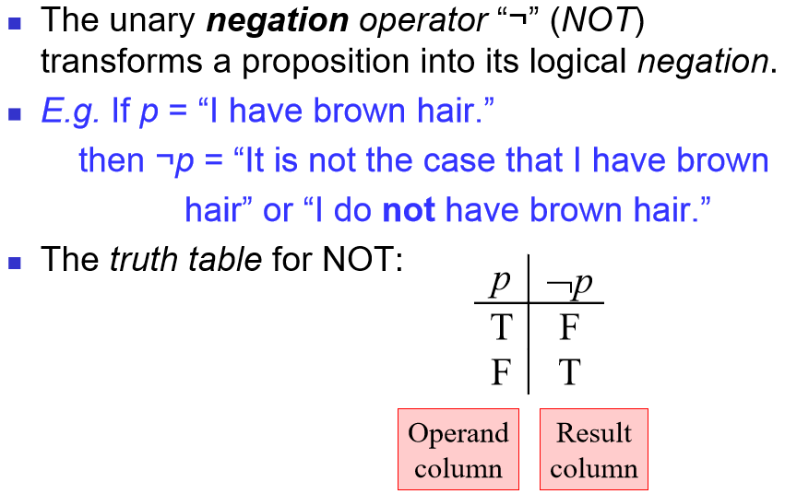
The Negation Operator

Slide 12
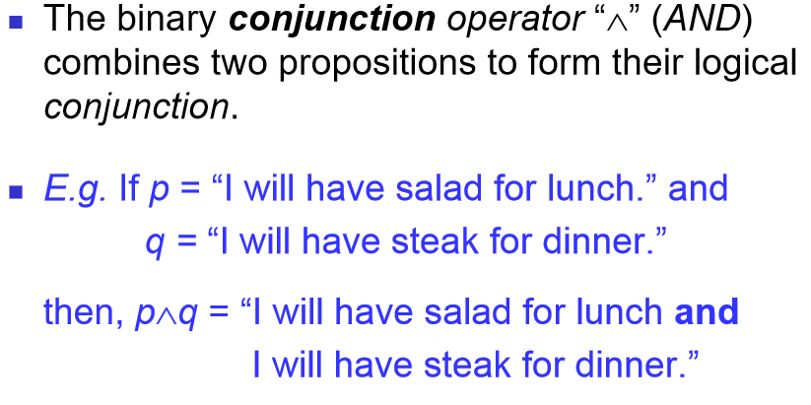
The Conjunction Operator

Slide 13
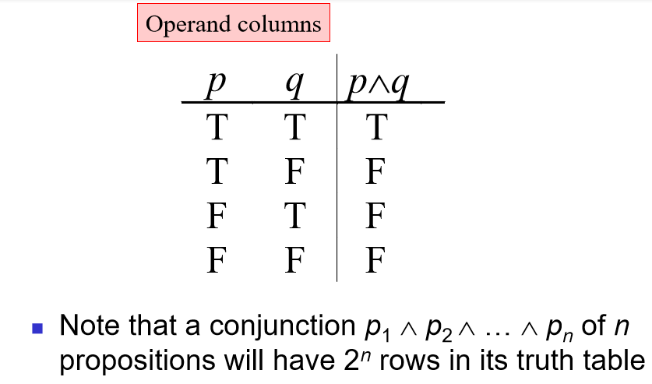
Conjunction Truth Table

Slide 14
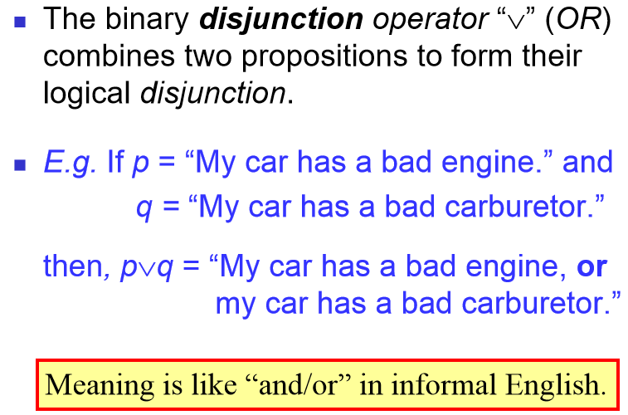
The Disjunction Operator

Slide 15
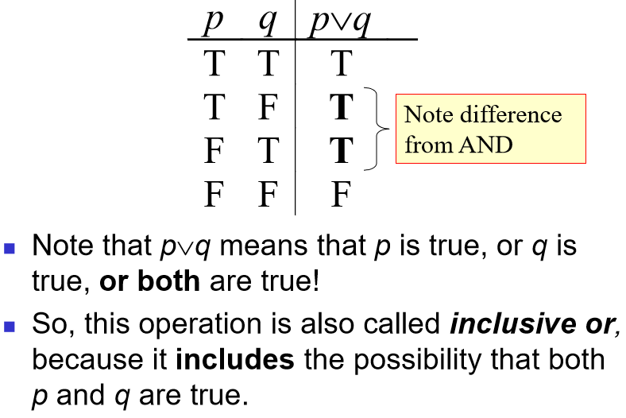
Disjunction Truth Table

Slide 16
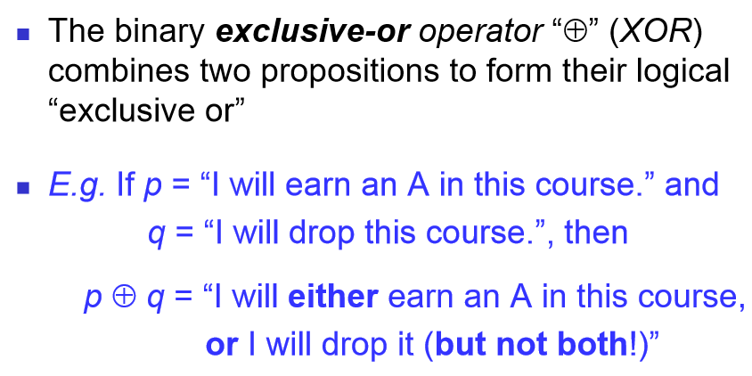
The Exclusive -Or Operator

Slide 17
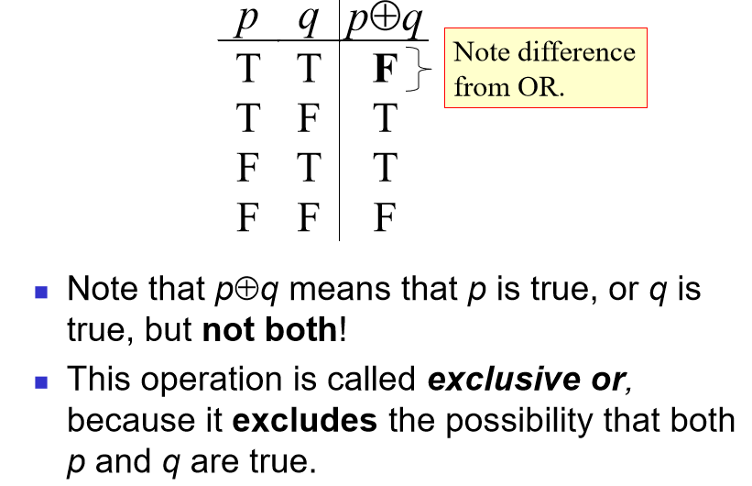
Exclusive-Or Truth Table

Slide 18
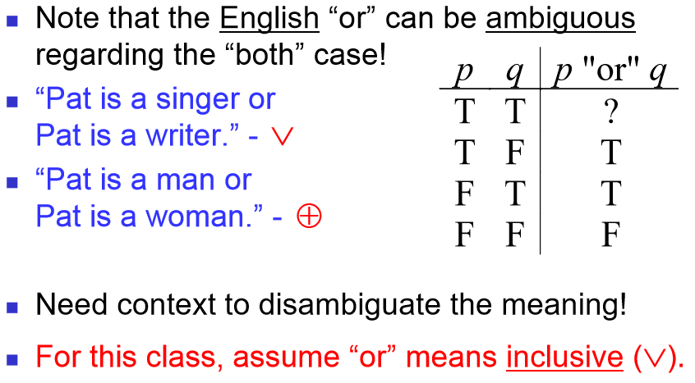
Natural Language is Ambiguous

Slide 19
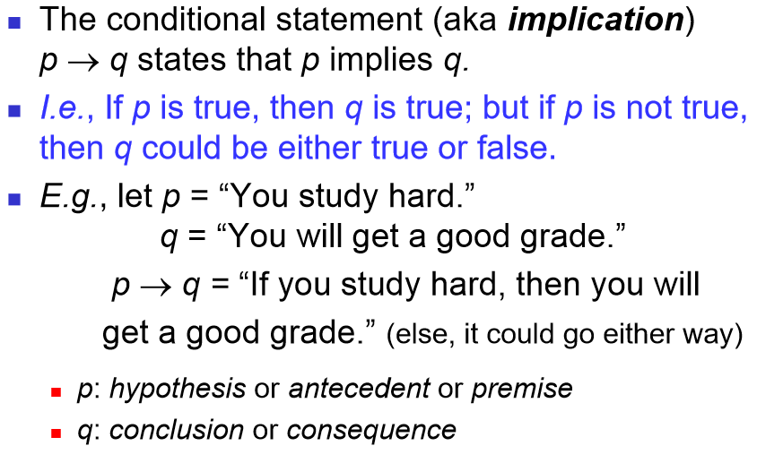
The Implication Operator

Slide 20
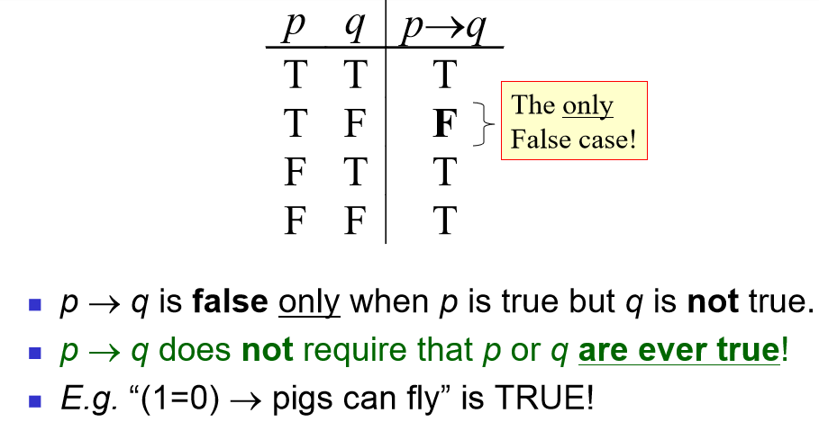
Implication Truth Table

Slide 21
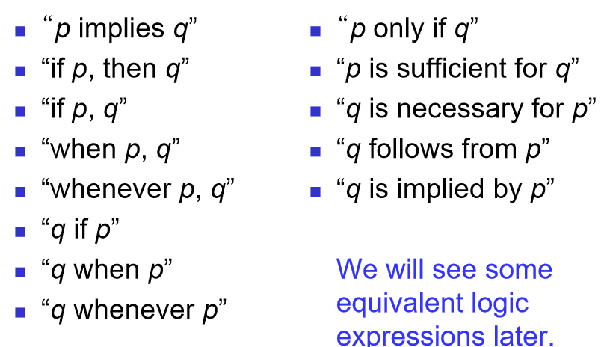
English Phrases Meaning p → q

Slide 22
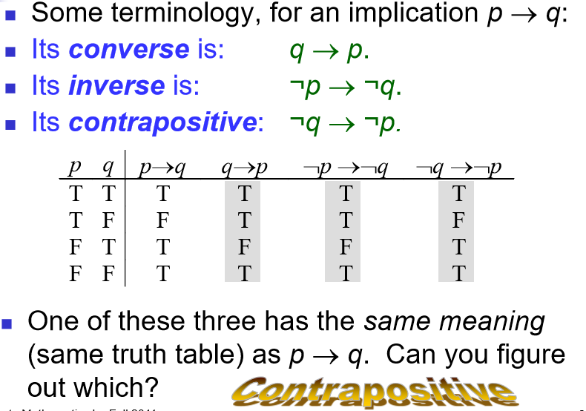
Converse, Inverse, Contrapositive

Slide 23
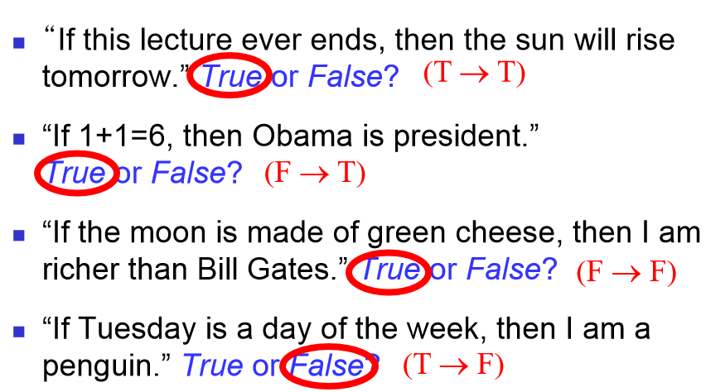
Examples

Slide 24
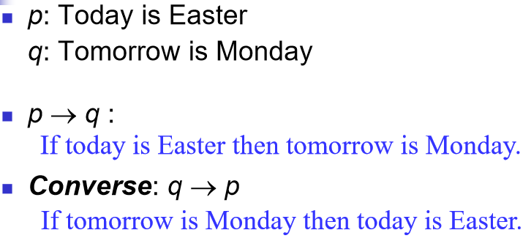
Examples

Slide 25
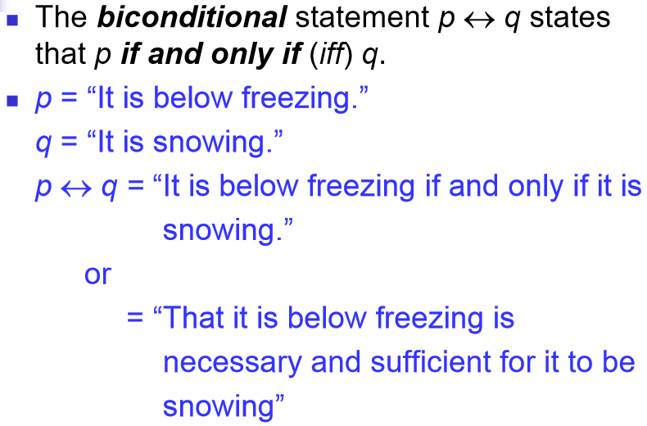
The Biconditional Operator

Slide 26
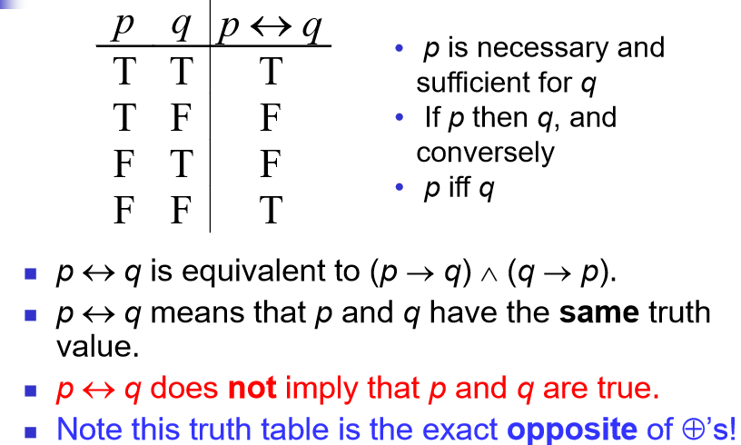
Biconditional Truth Table

